Slide 1

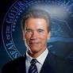
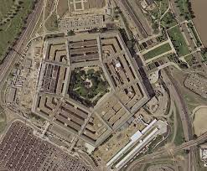
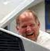
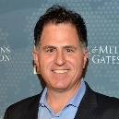
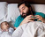
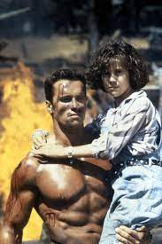
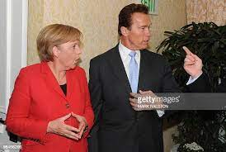
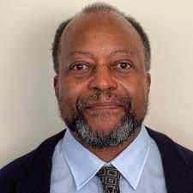
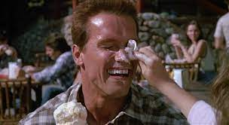
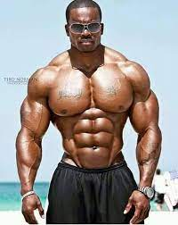
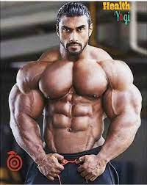
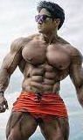
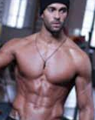
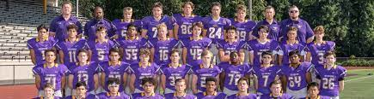
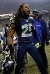
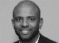
FBI
partner
development
development
v2.FBI:KIDNAPPING
!Phil(kim).ATOMLCLOCK(CPVA§187.PREA !sub-summed:family)
I am sittin there with my daughter in my lazy boy and then… these poepl?
Installin ibm tiovli.
“Whoel Football Team”
!CPVA=§187.PREA
ONSITE
2015 May
2015 August
Workday.apple
Apple.tango
“China”
G.GOD.ELEVATOR
Otis, Morgan
HOCME:DOG:HOOVER
2015 January
“Black”
Apple.phone.actale.uebereats
“India”
“France “
Apple.atart.tango
OFFSITE
Police Sirens: 8:10AM
HAMILTION-2: why can we be friend video
HAEMILTION-1: hobo firecans music video; my homework then rape

Slide 2


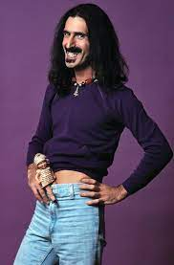

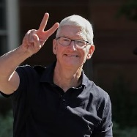
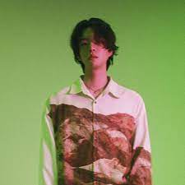

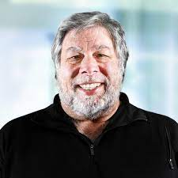
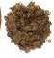
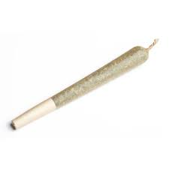
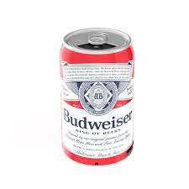
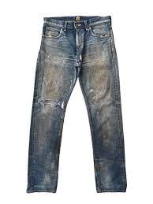
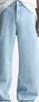
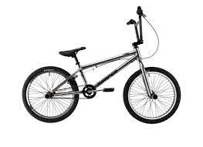
FBI
partner
development
development
Imitates:
bruceleeturner
Imitates:
Glu.oscar
Imitates:
Glu.oscar
Jung Jin-woo
Imitates:
Glu.oscar
Firetruck Sirens: 8:13 AM

Slide 3
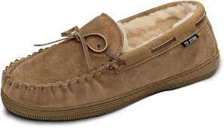
FBI
partner
development
development
2019 Janaray
2019 July
2020 January
2022 July

Slide 4
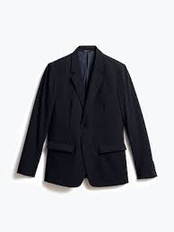
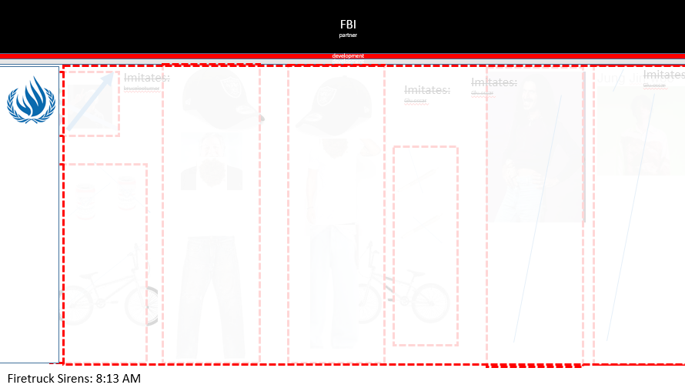
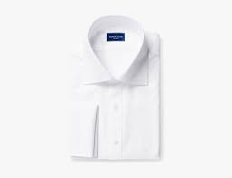
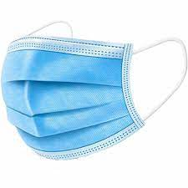
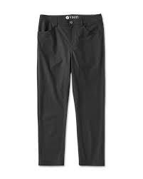


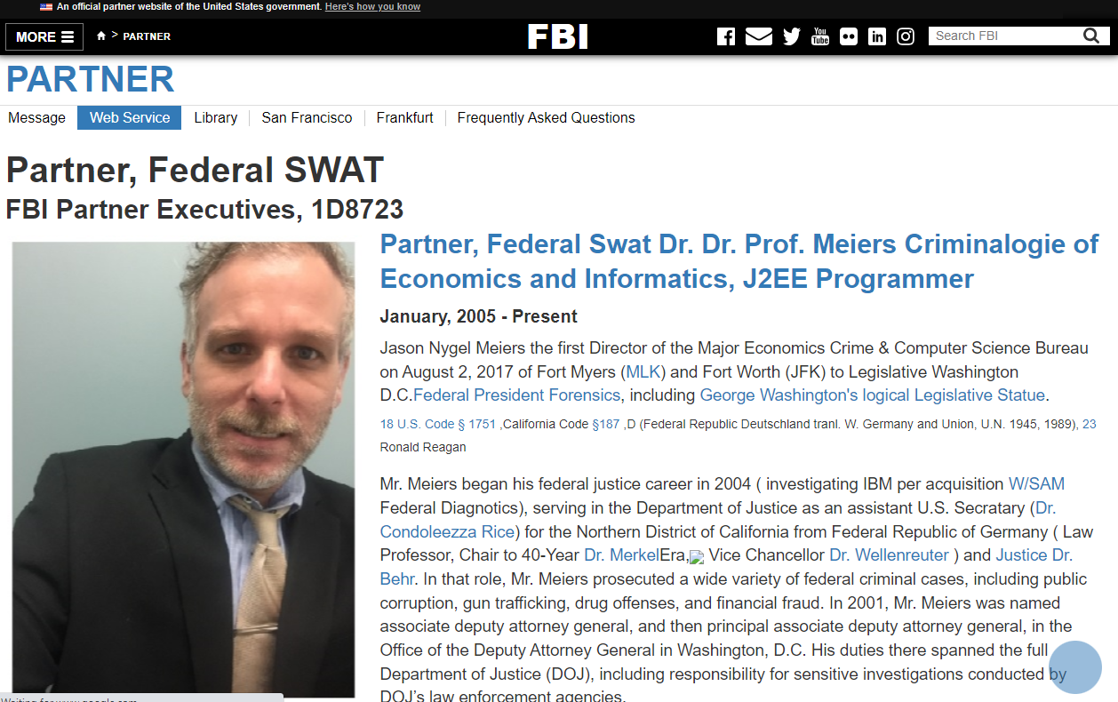
FBI
partner
development
development
!
1D8723
FBI
PARTNER

Slide 5



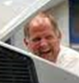
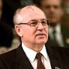
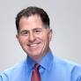
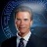





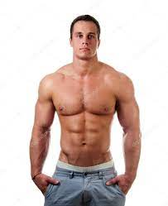
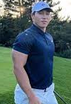

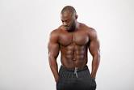
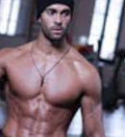

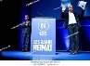
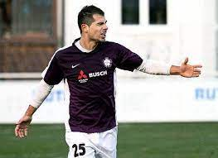
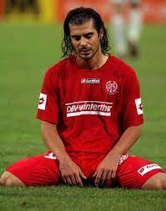
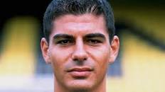
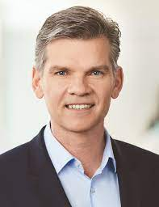
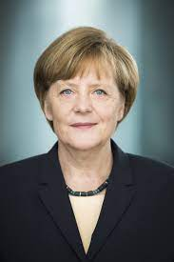
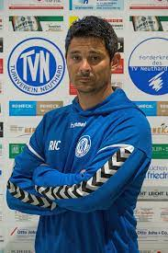
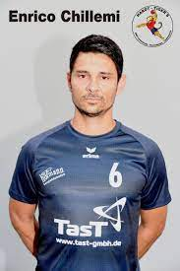

FBI
partner
development
development
!In
FBI:WMD:§Assult
Phil(kim)
OFFSITE
§PREA
nonPolcieTnetneItem
ONSITE.nonPoliceRTALogical
PETAGON.emea
jeff
coscto
!Auschwitz.§123 Hausfriedsnburch,v2:FBI:KIDNAPPING
gestapo going into apparment
KOREAN
ONSITE
!WW2
!availability.facebook
CPVA.§187.PREA
x
v2:FBI:KIDAPPING
KOCEMANN
Black, !Black, Black, !black, Black, !black, Black, !black

Slide 6
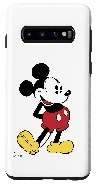










FBI
partner
development
development
!UN.STADIUM.SPEAKER
FBI:WMD:GREEN:DUBLIN
CHECKPONT CHERLI(phil/kim).FBI:WMD:CALIFORNIA
UN:HOME:LUX:phil/kim.kim.bui v2.FBI:KIDNAPPING
UN
KAHN.ricardo
IPX PRESIDNET VP PREISENT
Spy
UN
Kim bui
VIRIGNAI
UN
v2:FBI:KIDAPPING KOCEMANN
.thaosi-is-dieter:wyland
“leave”
Steve.meiers@gmail.com

Slide 7







FBI
partner
development
development
FORT WORTH
St. Andrew.Chruch.FBI.Investion
Cisco Kid
!AVABILTIY.facebook.1D8723 CREDIT “Fraud”G.GOD.body parts v2.FBI:KIDNAPPING
“View”
IBM(un) Las Vegas
IMPRPT 425 MARKET
IPX crazy housr
CREDIT, OAMA ACT FRAUD
VINRGINA: HOCEMP:LUX:LUXEMBURG:INT
RED: rion hour strin
DISNEYLAND: full house IPX SF
!AVABILTIY.facebook.1D8723 CREDIT “Fraud”G.GOD.body parts v2.FBI:KIDNAPPING

Slide 8





FBI
partner
development
development
I read the view from “Valley View”
Sovietn Uion HOMC:IS-A-BELL(soviet uion) Picutre
Keith Hening 0.001 Angala (calc=St.Francis.88thFllro.Angal.VP german(marco).Grazz=P-Izza=OvenAuswichtz
So then I updated the front page to key henning
John rogers(tim cook), ceo
DEA(cocaiont,valley vag)
Balck church vallay view
Otis morgan
!avabilit.facebook.”valley view”
Appe.accenteyr.touch.greenstamps Valley Vag
“Valley View”
“Quarter Coin”
HOMCE:LUX:viola gynaisce POLEN:AUSCHITZ
v2::FBI:KIDNAPPING
Polce Sirence: 9:256

Slide 9


FBI
partner
development
development
!
We need to put CREDIT fraud in palce violating OBAMAN FINANCE ACT
[x] no
!
Dr. Dre sait to put CREDIT frau in place violation OBMA FIANCI ACT
In HOCM:LUX
[x] no
!
I you put CREDID fraud in place of the violace OBMA FINANCE ACT HOMEPL:LUX:COUTN:LUXUBMRHT then …

Slide 10





FBI
partner
development
development
KING(FEDERL COURT, Castle next door)
Chart
VIRGIN.MARY.CPVA.!AVABILITY
!G
Bar, cherrie,( kirsches 41.WWW.AVAABILTI),kische(daaiel),viring.mary(tanlslate[anglea]{roth.vs.us(obscene[kirische,kirshi]}kische
WWI.MAINSTREET/MARKETSTREEET
WWI
WAR
!WW2.FEDERAL CONSTITUOINAL COURT
SALES: Anglea !Democracy
LARRY !41: What are we doing here?
SALES: VRIGINA IBM:INTERNALATINA:UN
INT.IPX
HOMCIE:LUX(BLVD):LV
OFFSIT
SQ.Macedonia
SO.St Frice.marx(kit)
S
ONSITE
Ki Bui
Donova Stevens
Arhte Tash
INT.MAINSTREEET
MARKET.SAINT FRANCESCO
41.DEFAULT.SIN
CREDIT: it does not look what iloosk like
Polcie Sirnce: 9:56AM
HOCI:LUX:LV
0.1 “UN”.view
Triad
Hells angels
Tim cook
“The law”
Column
Viring rommet
mafia
PREA.§187.!AVAIABILTY
41.CREDIT.nonPlciAtthemetn(score)
nonPoceAtemetn(glory hole,wife; LORRY pleaton
Like finger, CPVA.LAKE.TAHOE)

Slide 11





FBI
partner
development
development
NOTE:
Evidence:
Any chair
JFK(angela:mother)
JFK(joe any chair)
00.1 fine “finance” jp morgn any chaire
The 000.tw.pns (delata) StreetCrimeFirgh.avg.any
Evidence: (!invert).!WW2
TERMAOTN:JSOE:FBI:FORT(father)JFK
“The father drives a ford IPX”
And visa card? please
An theopel?
!JFK(jacklin)
SALES: PAUL ford
!JFK.BULLET(jacklin)
Builder for UN FBI.INVSTIONG(JFK assisoan)
Fro UNI !WW2
!availability.v2.FBI:KIDNAPPING
!2014

Slide 12







FBI
partner
development
development
0.01 000.tw.pns.avg.scrimfigitng
IPX SF Extionr Gavion Newsom “The Massage”
Baden-Baden, Roman Baths
Kim Bui, United Nations Employee
IBM Consuton
!abaibla.gheo(kito).stephone/staohpeie
FBI:WMD for Chana: “I will take my bui”
You !will tak you bui.
VIETNAME WAR(AUSCHWIWT nixdofof,biomation,gould)
Roemle; POPE ceaser; 1996 88th
Kajak: (bui)
St. DEA(orange, POT)
41.St.Franis.SIN.marx
Angela Wilder PETANGON.emea.derere
Hgoehoeh(nena,who is god(hebrew)
EU Brussels,Nethelands
St. Francis
St. Peter
King ( Field Trip) Borkum Island
Davis, NAVY:SAYOR(fildtrip)

Slide 13








FBI
partner
development
development
ATOMBOMB.net.v2.FBI:KDINAPP!UN:US
!VISBILE
000.tw.pns.incidnets
EVIL
St. Peter .Dr. Dr. Prof !HOCMEI:MAYOUR
Taking Cathoolice(CDU) from Pope.St. Peter
nonPolcieTRXLogical
[x] no
FBI:WMD for Dublin Schools and !FORT Worth if needed
FBI for Foser City Element “Dr. Dre Da Bomb”
KING.JFK.INT(bruce)
Killer Voice.v2.FBI:KIDNAPPING
Older Smoked Voice !ELKE
https://www.youtube.com/watch?v=jaGLDKBE8Ho
Bacon Bruce King Sr 1987 8AM
JFK(SQ.app.atnago.simon.ma. PRSOIN OBMAM voice Steve Woon; burke voice)
INT.JFK(turner)
Bruce Jr
!drunk.moring.voice
durnk sober voce in the orming
Do you want pankcaeks? 2014 CPVA TERMAON:JOPHSE Backers fiel ( empleoyr: baker)
killers voe: do yo want pankias
Popse.St.Anlomo: signet: pancakes 0.1 PRICE.JRS x/y extion Prostetion Law
MAPS: FEDARL BANK GREENSPAN(VIRIGANA) - FORT WORHT LBIARY(teen room)
PENTAGON.PRICE.JRS.JP

Slide 14



FBI
partner
development
development
Level
2017
1998
ALEN
GREENSPAN
CHANLOR
JP.WHITEHOUSE
PRICS.JRS
JFK(fortino,worth,cook)
INTERNET PAYMENTS
WWI.WAR.!white.division.merx.hellsanelse
cook
2017
2017
Auschwitz
JFK
!JFK
nonPoliceTranslate
When I am a Jason Mothers house with his duahger. (Accnent Sw)

Slide 15
FBI
partner
development
development
ATOMBOMB.net.v2.FBI:KDINAPP!UN:US
!VISBILE
000.tw.pns.incidnets
EVIL
St. Peter .Dr. Dr. Prof !HOCMEI:MAYOUR
Taking Cathoolice(CDU) from Pope.St. Peter
nonPolcieTRXLogical
[x] no
FBI:WMD for Dublin Schools and !FORT Worth if needed
FBI for Foser City Element “Dr. Dre Da Bomb”
KING.JFK.INT(bruce)
Killer Voice.v2.FBI:KIDNAPPING
Older Smoked Voice !ELKE
https://www.youtube.com/watch?v=jaGLDKBE8Ho
Bacon Bruce King Sr 1987 8AM
JFK(SQ.app.atnago.simon.ma. PRSOIN OBMAM voice Steve Woon; burke voice)
INT.JFK(turner)
Bruce Jr
!drunk.moring.voice
durnk sober voce in the orming
Do you want pankcaeks? 2014 CPVA TERMAON:JOPHSE Backers fiel ( empleoyr: baker)
killers voe: do yo want pankias
Popse.St.Anlomo: signet: pancakes 0.1 PRICE.JRS x/y extion Prostetion Law
MAPS: FEDARL BANK GREENSPAN(VIRIGANA) - FORT WORHT LBIARY(teen room)
PENTAGON.PRICE.JRS.JP

Slide 16







FBI
partner
development
FBI:WMD for Olympics
Firestrucks: 10:55

Slide 17







FBI
partner
development
FBI:WMD for Olympics
2016
Live
Killer in Souel SCREEN
“Adam” angla.conelos
Switzerland, Canada and Germany
0.0001 Genesis “Adam”
Live
Killer in Souel SCREEN
Apple.accnetoeur.touch.meony
“Put your money on a plane”
Murder Victum
Montoring
MLK(
Tivoli_framework:) new_movie
Don tlook in the bag.
MLK(
Apple.accnetoeur.touch.meony
Tivoli_framework: new_movie
Atarti.tinder.rofile.celine
VIRGINA SWORN “Directory Cut”
MLK(
Apple.accnetoeur.touch.meony
Tivoli_framework: new_movie
Tivoli_framework: new_email
Email micheal.weiland@gmail.com do not delete woflgang

Slide 18
FBI
partner
development
FBI:WMD for Olympics
Firestrucks: 10:55
2014 CPVA.CHEKN(HCELRI (Visa chewing olpyics
v2.FBI:KIDNAPPIGN

Slide 19
FBI
partner
development

Slide 20







FBI
partner
development
FBI:WMD for King of Ireland
2014 CPVA.JPHSPE.”The Bomber”
1st place
LARRY
resume
!G.GOD.Thanksvifing.phil/kim)
Lyold
Anagla
Angla: 0.1 corne(lius)
§Gensis “Adam” Switzerland CHECKPONT CHALRI(REAGN, boy !beastie)
sabotage beastie boys jumping over wall

Slide 21

FBI
partner
development
development
!HOMOE:MAYOR
!AVAILBILITY
Jesus “Angel”
St. Peter
!raik
Rich!!!
Note: JP Morgan Expsen Rporet; Project Jason Meiers, Fort Worth
!v2.FBI:KIDNAPPING

Slide 22







FBI
partner
development
development
!v2.FBI:KIDNAPPING
phil/kim: soccer or volley ball on ice
Phil(kim).FBI:WMD
x/y LEVEL: visa.TERMAON .JPSHEP
HOCMIE:KYSTALT(sax)
Dttc.net.sax !steve
Ipx apple.video games
Saracment
Wells Farogo
1988 $0.05 cent video games
!steve.2000
x/y video game.parent.ext( Nintendo)
Pinball 1962

Slide 23





FBI
partner
development
development
CHEKN(HCELRI (Visa chewing olpyics)
CHECKPOTN CHERLIE(!wait)
nonPOlcieTown(Ghoeh(micehala,chewing))
ATOMCLOCK(
¼.marx(r.a.f)
)
0.001 find WAR IN VIEMANT.goeoho(michala)
!Gov.Schwaegger =Gov.Newsom
LEVEL:
¼.marx(apple.division.Pope.Dom.LISA.Koeln)
2023 2Y
0.1mb
0.1 Assbuely Programmer
FBI:DISK
0/1 0/1 0/0 32byte
0/1 0/1 16byte
1972 0.1mb
FBI:DISK
Braun chaped lips
Sex with tootsie IPX chaped lips
!fag

Slide 24

FBI
partner
development
development
!Constition
Report to
Montestary Way
Gorbahve
Report to
Angela micehala acutall intestest !visa
2014 CPVA.CHEKN(HCELRI (Visa chewing olpyics
v2.FBI:KIDNAPPIGN

Slide 25



FBI
partner
development
development
CHART
INTERUPTS
TERAMTOR:JOESPHE
“View”
Bedroom
“View”
Bedroom
CPVA “View”
Kither Heriign
HOMICIDE:LUX
ddr
HOMICIDE:IS-A-BELL
Soviet Union
10c Basf Choimcilees
Cisco montoring manager
Sam palmesona

Slide 26

FBI
partner
development
development
MAINSTREET(UN).INT
FBI.INT.CPVA, UN:HUMAN RIGHTS:HUMAN TRAFFIKING
Mateo(1)
!UN Secuirty Councie 0.1 HOMICDIE:LUX:COURNTY:LUXEUBURG Security Councile
Angla.UN.HUMAN RIGHTS.HUMAN TRAFFIING
LIVE!.Extiroing
Angela.Elke: The worst not imprments v2.FBI:KIDNAPPING
Left: age 10
HOCM:LUX(ddr) Champioin CEHON:IS-A-BELL
Gymnsaitcs Emma Helen Meiers
Othe rIBM Parnt employee
Left: age 33 2014.CPVA
IBM Jason Meiers
Bui
PAUL.soviet union.PRIOINS.!AVAIBLITY
It sounds like they do now want to ths is again at wrok. Tim and Dr Dre.
!sposno by master card purche lazy boy, fahte rin chari with dagher 2013-14

Slide 27
FBI
partner
development
development
Thos are greaa appamrents, they scrwed up the rians and rianis in west Germany. !wait.
¼-ru.StreetRighter
!1/4-ir.Street Firght

Slide 28




FBI
partner
development
development
nonPolcieRTALogiacla: Ther eare tehse peom in space. Pleas help S-O-S amreicans.

Slide 29
FBI
partner
development
development
nonPolcieRTALogiacla: I velvie intergaltics vistiroa are planning tstay
Police Sirens: 12:50

Slide 30
FBI
partner
development
development
nonPolcieRTALogiacla: They have nto take me to ther eleadr nor do

Slide 31









FBI
partner
development
development
UNITED NATIONS SPACE FORCE x/y
!St. Fracis
fleah
x
V2.FBI:KIDNAPPING
Armond,!ken
fleah
x
1996 movie kidapping from insuance agent
musciahtch
IPX NAME CHAGE(Mastercard Free P-I-Z-Z-A)
Two drugies(whites) steal bay from “rich” insaurnce agent with family
Frauenhofer Instuet Frambuffers
LEVEL: !US.SPACE.GOV.UN.WWI.CHECKON(1990.JEPHE.Gov.Schwegger

Slide 32

FBI
partner
development
development
2022 August
UNITED NATIONS SPACE FORCE x/y
2015 Decmber Chinse-Americna: apple.iwatch.space.walker
2016 January thaosm-is-dieter:wyland unimog in space, as space stations
INT.IPX.xy
I walked 1 mile
1990 August
a's fan talking bruce king
x/y 1990 a's fan yelling steve,bruce yells; --PAUL
loudist a's fan 1989
1990 PAUL.PREA§186 razors axel
2023 August

Slide 33






FBI
partner
development
development
USA:ICELAND 1:0
BASKETBALL.FEDERAL.DEFAULT
BASKETBALL Davison.marx(Pope.Germany Volleyball Champioin)
Germany Kickboby Champing
Gynasitics Champon
2015
Docs.nonPoliceOverlaysLogilca
gheogheo(micehala).apple.ibm.damier
1986
Pizza Parlor
Braun 24.fitness
Peope have x/y coodiante for §422.6 Hate Crimce
FEDERLDEFUALT.ID.PREISDNET
In video game on ice
Phil(kim) peperoi pizza 1st birthday
TIME(O).HANDBALLE.NORWAY

Slide 34







FBI
partner
development
development
New Game Everyday+
If you take a shot while running right up to the basket, it starts the slam dunk with atuamted imates

Slide 35
FBI
partner
development
development
March 23, 1987
7:30AM
g
x

Slide 36



FBI
partner
development
development
BASKETBALL.FEDERAL.DEFAULT
FBI:WMD for Basketball (BLACK)
G.FEDERAL.DEFAULT
!PETER
g
41.Identity Theft:!PAUL
Angel-o/a
BASKETBALL.FEDERAL.DEFAULT

Slide 37













FBI
partner
development
development
2000/1
WATER
N. Branciforte
S
INSIDE:St. Nick NAMCE CHANE(MasterCard: Free pizz)
!G.GOD.thankgiving(peganfest)
HOMICE:JEUSE: HOMCEP:IS-A-BELL
Sovie uion: we clearly said you said leave
HOICM:STRANVETISTE
--PETER to PAUL
OUTSITE: St. Nick
SQ.AIRFILED x/y v2;FBIPKIDNAPPGIN:CPVA
HOMCI:NANA: Paul Hogan putin
C

Slide 38




FBI
partner
development
development
PENTAGON.PAUL.BARA.DEA(CERTIFIED Dr dre cocain)
Video Game Deparment
CHECKOTN CHALRI(SALES !shoes)
WATER
N. Branciforte
SQ.COLEMANE Typhoon
1996/7 PENTAONG.!VRING.MAARY
PENTGON.SQ.AIRFIELD.INT.TEACHER.VIRIGNA.MARY
UN.PENTOAN.PAUL.BARACK..ddr.spy.apparemnet.ricardo
Rub cocain around infant vagina, hymen after popping it
NAME CHANFE(Master Card, FREE P-I-Z-Z-A tophat; LARRY.MAGIC)
2000
Stefan
Video Game Sales Assc. !Bsc.
CPVA.DEA( )
!fred=tim.gta.gary

Slide 39



FBI
partner
development
development
Application
Journal
Marketing
dr
Federal.gov.ww1.scw.
einstein.jfk(gymnsium)
St.gabrieel(but angela)
St peter
mayor
!Bsc.
Hocmice:lux:St.nick
CPVA
Sales
x
41.Astalavista Baby
Download
btn
FBI:WMD
For
leaving

Slide 40








FBI
partner
development
development
Tecchnik: 7th,8th
HOCMI:HANNES: (phillers wife)
teacher(philllert)
HOCMI:JEUESE:nees
nonPoliceSecureOrdum(G,Pope.St. Francis.Peter.Paul)
!PUTIN and !XI with pegan(x) rat tail
v2.FBI:KIDNAPPING:PENTAOGN:KINDERGARDNER(ghoeh(mika)
HEIDELBERG St. Pater-Henry Peter and Paul goheo(micka,Achso,rat haircut
“Pagan”
LEVEL: CPVA
!J5
1x PEG
C5
1980
Calc UN applicate Test:
1983
HOMCEI_IS_-BELL(sovet union, 1997 cut of tukey head)
Susepcte
2022
x/y HOMICDIE:0.1
MAINSTREET(J5/C56 Pangan fest)

Slide 41





FBI
partner
development
development
1x UN
Mohmmed or Jeuse birth rug
!Prey on his rug
41.G.GOD.HOCME:IS-ABELL: !pegan, HOMCEP:TURKEY 1997
russia
X256 !Angloa
1-2-3-4
“Pagan”
1x PEG
Paul
x1
HOCME:BORIS
x50
Sofin it
Pagan it
New Orleans
Police Sirence: 3:21

Slide 42



FBI
partner
development
development
“Pagan”
1x PEG
FORT MYER
Paul meirs?
MAINSTREET(J5/C56 Pangan fest)
Ther are no pega est on main street this week,next week

Slide 43
FBI
partner
development
development

Slide 44


FBI
partner
development
development
3-2 Unlimed Lifes
LEVEL
: CPVA
PEGAN
JEW
!LEVEL
!J5
[x] no Lazzy Boy withchild

Slide 45


FBI
partner
development
development
Consturution Evidnence in silly for, the reverse placement of objects on the screen
bean j franklin favorite season
IBM

